Slide 1
DEVELOP AN OUTCOME L2
Evidence of Learning Template
0137829906
Project Title
Project Pong

Slide 2
Github /Drive link
Trello board or PM link
Trello Board After every task is in the done list:
https://trello.com/invite/b/xHqJGhks/79d9296531be7cf676855171a7da1c9d/digital
Trello Board Before every task is in the done list:
https://trello.com/invite/b/HhiIF0lO/13e34509135ccb4c4f0aac84ce0d35a2/digital-board-backup
You MUST provide evidence showing how the problem has been decomposed, how the components have been developed and trialled, and of how they have been assembled and tested to create a final, working outcome.

Slide 3
Project management: Setup
Record evidence that you have setup project management tools to manage the development of your outcome.
Record evidence that you have chosen project management techniques to manage the development of your outcome.
Record evidence that you have setup/ chosen version control tools/techniques to manage the development of your outcome.
Explain why you believe that these tools and techniques are appropriate for the development of your outcome.

Slide 4
Project management: Setup
Trello was chosen because there was at least no restrictions on the amount of people, no distracting ads midway of planning and very little restriction on how the program can be used. Monday.com compared to Trello can be a lot more complicated and not to user friendly. Trello is the better option in both functionality and ease to use. Monday.com is for more complicated projects. When I first tried it out, it looked very overwhelming and confusing on what I should do. I didn’t really have the time to learn how to use monday.com as I only has a very limited amount of time. Google calendar is also very limited on what you can do and it can be very annoying. For example once you create a event on a calendar you can’t move it to a different calendar and its has very slow syncing, it takes hours to sync.
In Trello there were many useful techniques to manage the development of my outcome. One was recording the history of the work, where if something was deleted by accident or I need to bo back and rewrite something, it was easier. Another technique was doing a daily update on the trello board. Any issues that was encountered was written and updated on the board, so I can try find a way to resolve it and stay on track. There is another very helpful technique was that I was able to set up custom commands. Anything that was not done within that week is archived onto the next week which was super helpful. I also set up a daily reminder.

Slide 5
Project management: Setup
 | Positives about using it | Negatives about using it | Interesting stuff about it
Trello | User friendly / easy to use Suitable for almost any project Convenient to use, such as drag and drop of cards Compatible with most devices | Limited storage Having many unorganised cards can get hectic. Does not function without wifi | Trello has a very easy, Drag-and-Drop Editing. Trello Cards Records Archive. Easy File Attachment to Trello cards.
Monday.com | Uniques and complex features such as: Time tracking on each task Different views of data such as bar and pie graphs Automations which take care of the manual work involved in completing repetitive tasks. | Not user friendly and actually very complicated for first time users. Prices for simple features are very expensive. Interface can be very slow and buddy | monday lets you automate various tasks, like recurring tasks, and streamline workflows. monday integrates with various third-party apps to streamline data flow and teamwork across your workplace software.
Google Calendar | User friendly / easy to use In a form of a calendar which helps to easily track tasks. | Lacks a lot of basic features. Can’t drag or drop events you put on a specific day. Can have slow syncing, sometimes it takes hours to sync. | Google calendar can coordinate people's meetings / calls. You can use your voice to control your calendar.

Slide 6
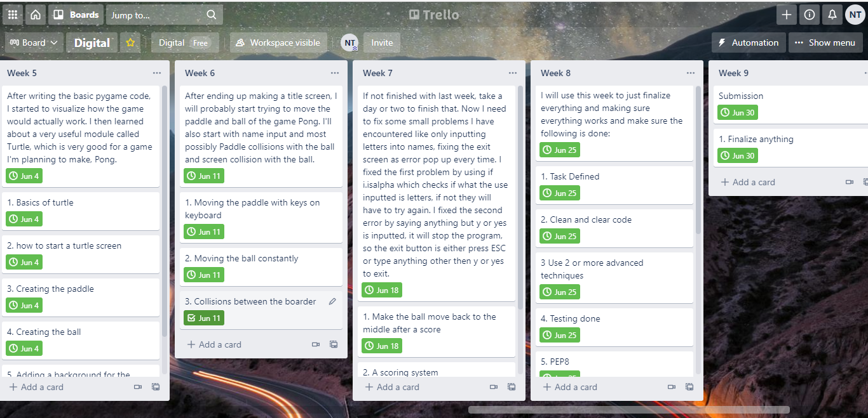
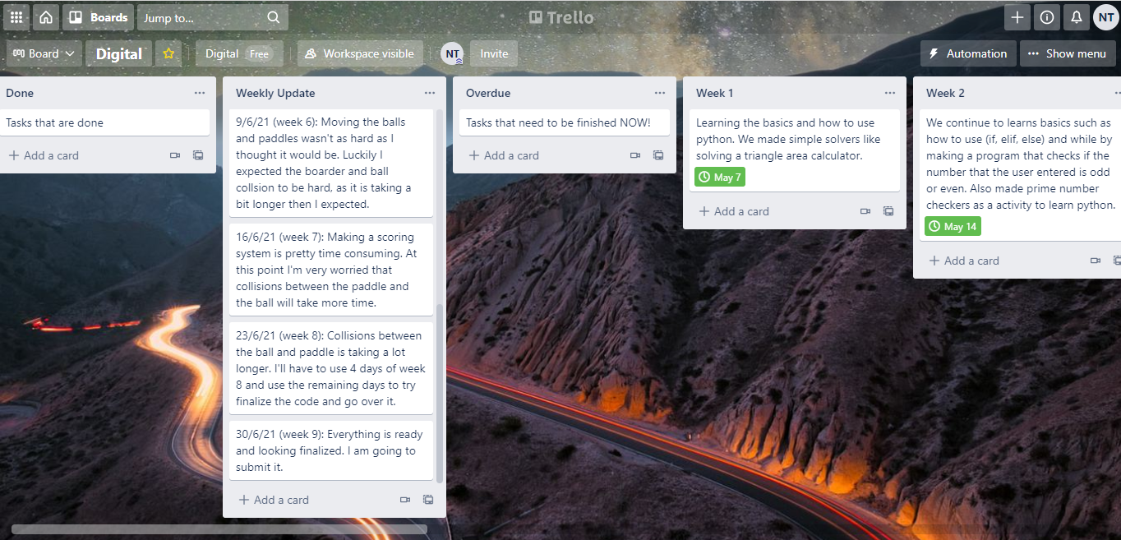
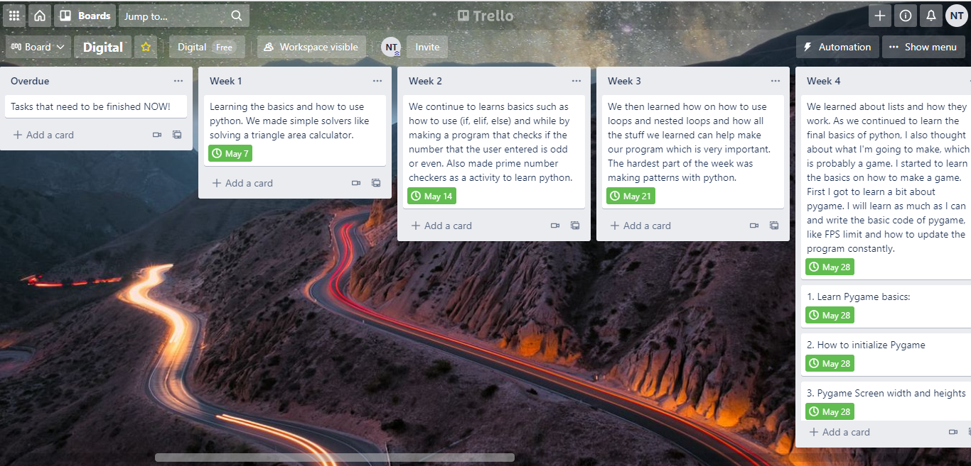
Project management: Setup
(Present this slide to see the images a bit clearer)
Homepage is under construction...

Slide 7
Project management: Setup
(Present this slide to see the images a bit clearer)
Homepage is under construction...

Slide 8
Project management: Setup
(Present this slide to see the images a bit clearer)
Homepage is under construction...

Slide 9
Project management: Setup
4.
I believe Trello has the required tools and techniques for the development on this outcome. There were many tools that I thought were appropriate for this outcome. The first one was the due date command. This command was great as a reminder to remember to finish stuff on time. This command can add a red label and a warning sticker to the specific week card when it is overdue. This was very useful as it was a great reminder on what I haven’t done. If I forgot to do that week's specific tasks, I would know as its very distinguish from other cards with red labels and warning stickers. This command applies for every week tasks, so any week task that was not in the done list will go into the overdue list.Another tools that was useful was the calendar command. This was a great tool as I can make commands such as every wednesday afternoon it automatically creates a card called “Weekly update”, which really helps to keep on track and where the development of this outcome is. If something odd like a bug pops up or something is taking up more time than anticipated, then I can write in the week update card what happened and how I plan to resolve it, such as the collision coding, I anticipated it to take up a week, but it ended up taking more than a week, so I planned out what I was planning to do. Another cool thing I can do with the calender command is that I can send reports every monday of anythings that's overdue to me email. Again this was very good as a reminder and every monday before I get onto that week work, the trello board emails me about anything overdue. One more final useful tool the board button and card button commands. With the Card button I was able to use it to move cards easily, the cards were the tasks I had to do each week. I also used the card button command to create done button, so whenever I completed that week of assignments, I click the done button and that would move that card to the done list. This was very helpful to keep track what was done as if it wasn’t there, I would get very confused on what task I need to do, worst I wouldn’t even remember what week I’m on.There was another very simple tool on trello where it tracks whatever activity has been done, basically a history list. Not only is their a activity tracker for the board, but there was activity tracker for each individual card, which made it very easy to track what I did on each card and how I can revert back to something if I didn’t think its right. The sharing was very to use as well, like when I needed my friend to have a look at it, I just simply sent him the link. What was easier was the collaboration for other people, There was a simple setting where anyone on the board can edit anything, which made it very simple and easy for other people to edit if they ever needed.(PMI. Plus, Minus, Interesting stuff)

Slide 10
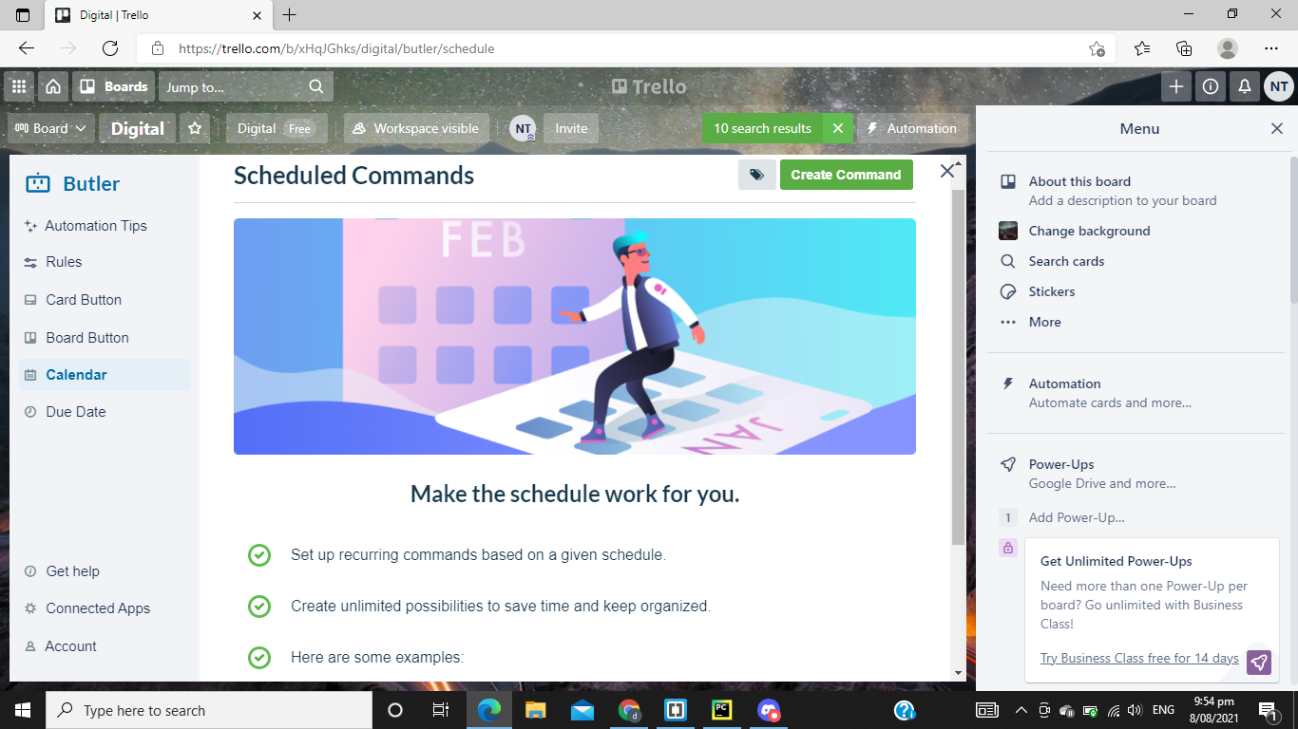
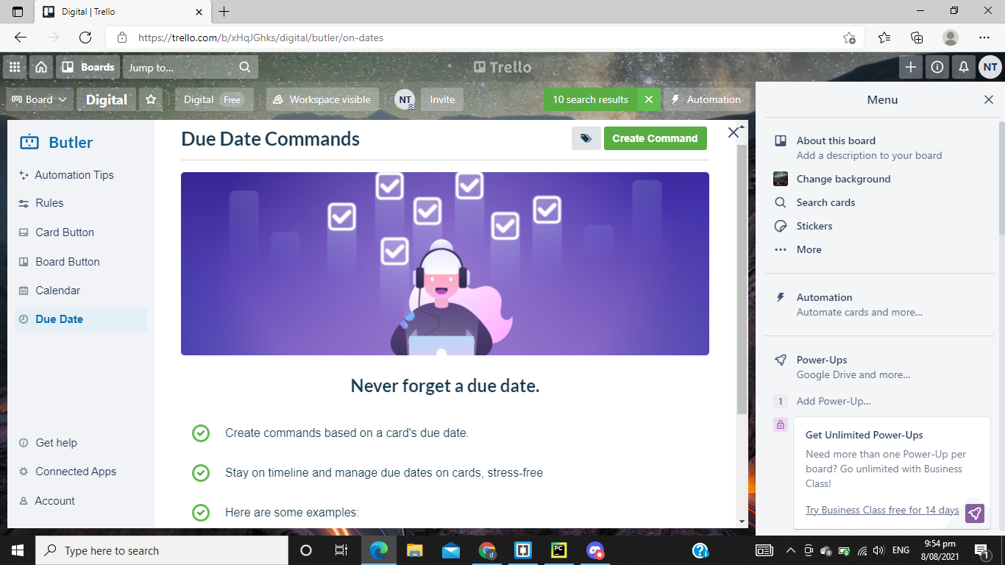
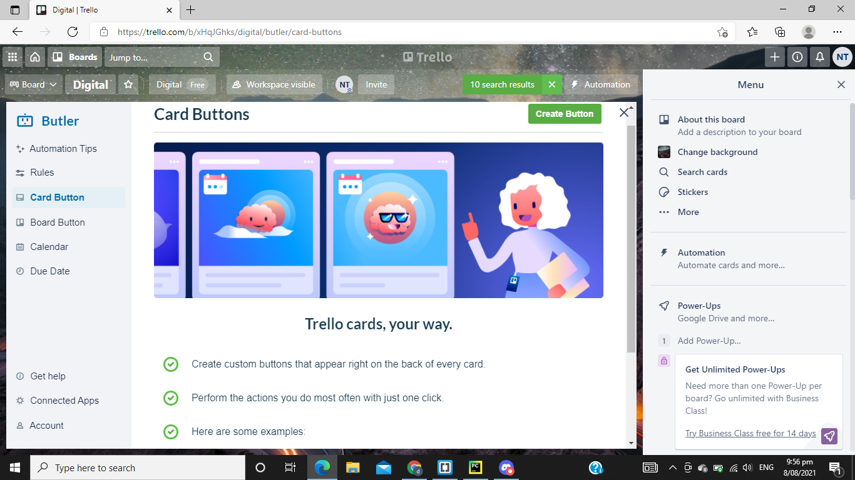
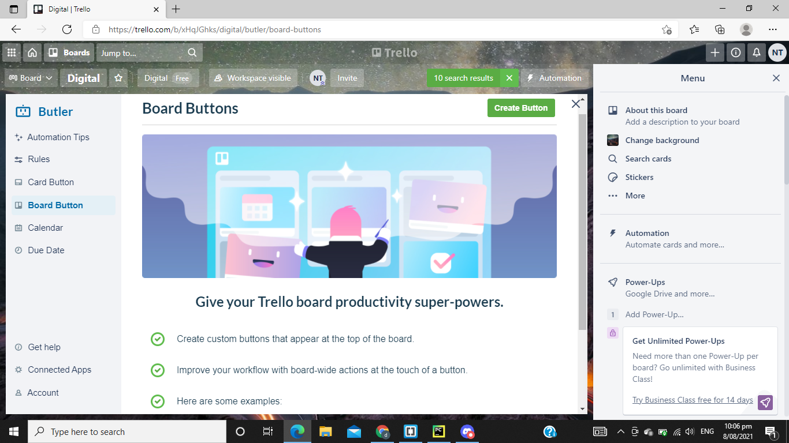
Project management: Setup
3.
(Present this slide to see the images a bit clearer)

Slide 11
Decomposing outcome
Record evidence that you have broken the outcome into smaller components. I have broke the weeks into smaller component making it easier to track stuff. Individual tasks were assigned for each week so a portion of the work is done.

Slide 12
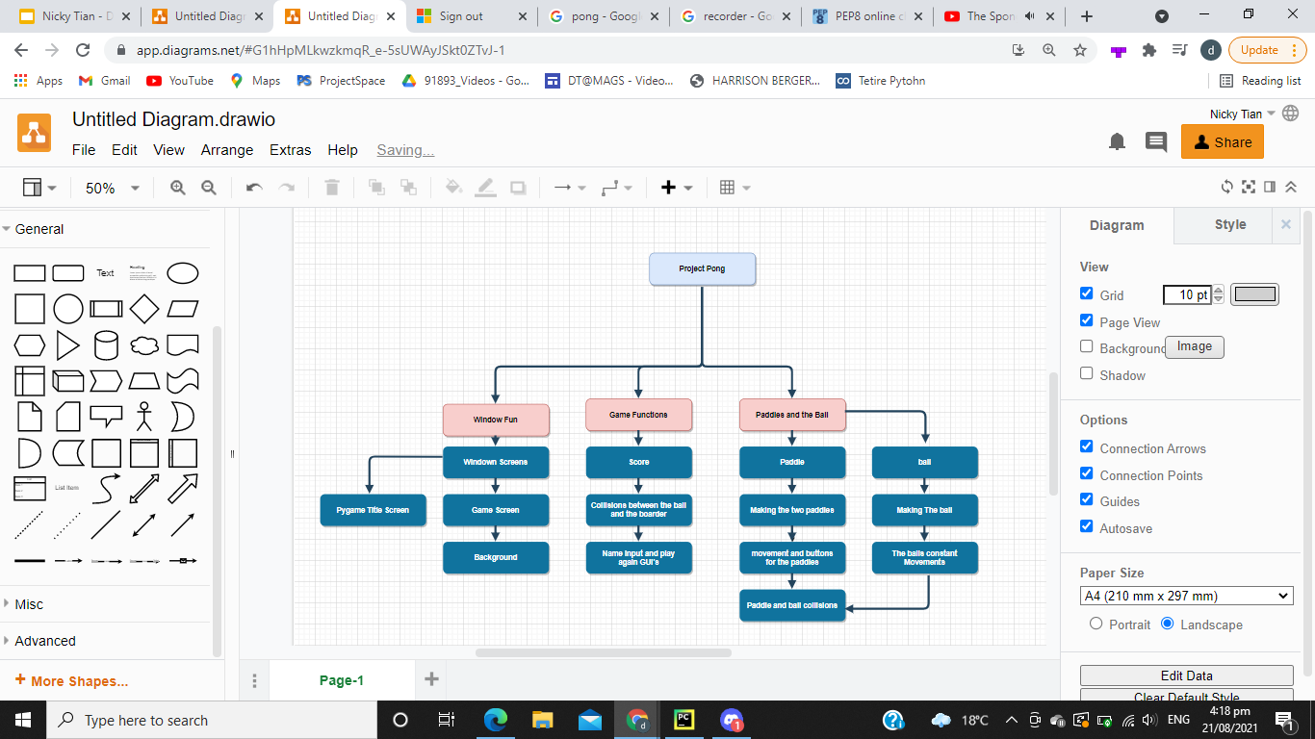
Decomposing outcome
Record evidence that you have broken the outcome into smaller components. I have broke the weeks into smaller component making it easier to track stuff. Individual tasks were assigned for each week so a portion of the work is done.
Present Slide to see the chart better

Slide 13
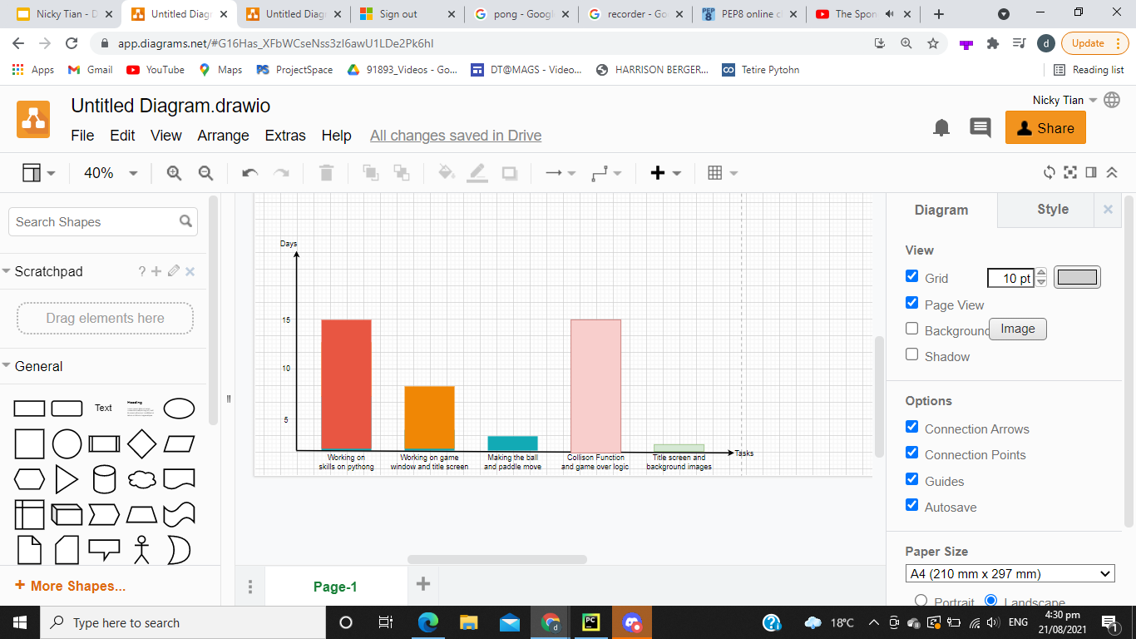
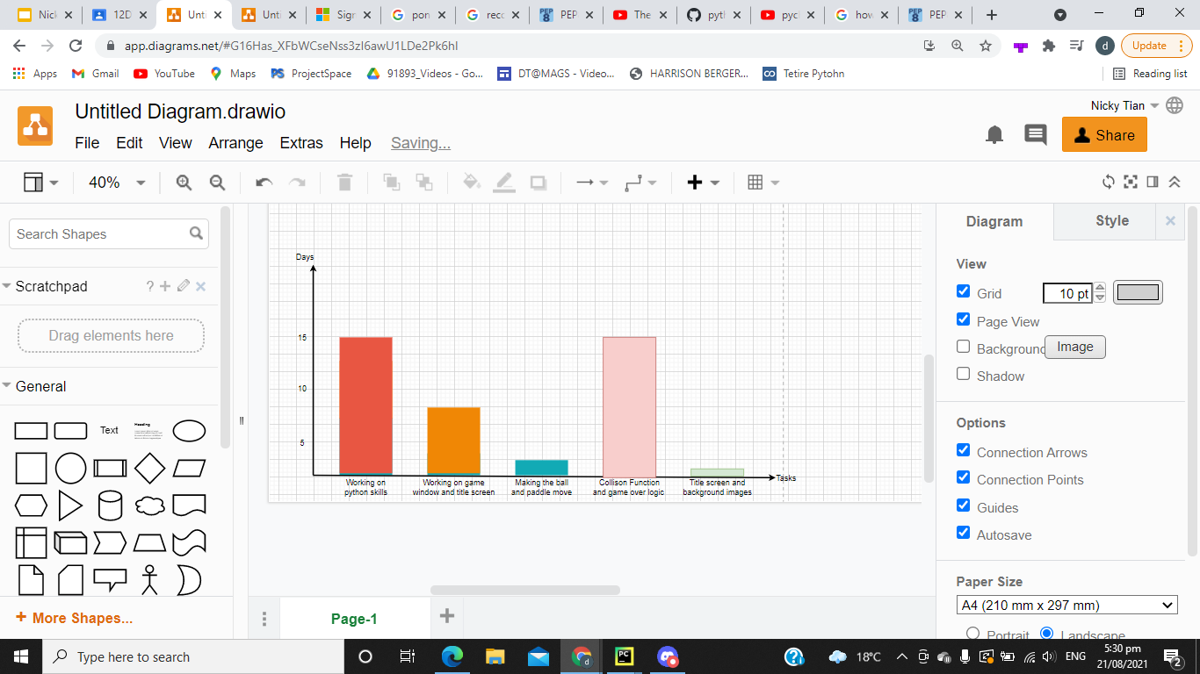
Decomposing outcome
Present Slide to see the chart better
Task Sizing
Graph Image still in progress....

Slide 14
Decomposing outcome
Project Pong was split into three main components
The window itself and its functions
Game functions
Paddle, ball and controls
Window component: This is where I code the window itself such as the pygame title screen, the the game screen itself, background.
Title screen: The title screen is a quick is intended to be a very quick introduction of the game, and simple instructions to start the game and how to exit. The title screen is its on separate window from the game window.
Game window: After the user press the start button the game window will pop up for the user to play. The game window is basically where the game is played.
Background screen: A background is made for both the title window and game window. A background image for the title window to act as a simple title. A Image for the game window to act as the field so the game doesn't look to boring.

Slide 15
Decomposing outcome
Game functions: This is basically the component that is required for the game to run properly, efficiently and as intended.
Collisions: This component is very important as this is one of the main functions that makes the game run. E.g ball collisions between the top and bottom walls and the two paddles/
Score system: This component is very basic and not as important as collisions, but still is best to include. Basically whenever the ball goes behind any of the paddles and score, their score will plus one.
Play again and Name input GUI: Again not as important as Collision to help run the game, but good to put in. The play again component is basically restarting the whole code again. If user says yes to playing again, it will restart, if no, then the whole code will exit and stop running. The name input is done to put against the scores, for users to know which score is theirs.
Paddle and the ball: This is what the user sees and uses to win against the other user.
Movement of paddles: This component is basically making the paddle move when the user wants to. This involves accepting commands from users.
Movement of ball: This component involves moving the ball constantly as in pong the ball never stops moving. This also involved making the ball going back to the middle after each score. The ball also moves in the opposite direction of where it scored to make it more fair.

Slide 16
Trialling components (trialling alternatives)
Record evidence that you have trialled components. Show that you gathered information to inform your decision making.
Record evidence that you have trialled multiple components and have selected those most suitable.
Record evidence that you have used information from trialling appropriately to improve the functionality of the outcome.
(Basically a before and after and how it was improved and alternative code did)
(thoughts on other ideas i could of added onto the program)
Comparing alternatives
Addressing Implications and Stakeholder feedback

Slide 17
Trialling components (Comparing Alternatives)
First I tested alternatives of what software I’ll use with python code. I didn’t really have any other choice on coding languages as python is the only coding language I learned. I tried to softwares, Mu editor and Pycharm. At first I tried Mu editor and it felt very outdated and it was doing really weird stuff. When I copy and pasted the code to Pycharm, the code was working a lot better. So I decided to use Pycharm. What convinced me to use pycharm more was that they had a version control for our code / history. So whatever I did yesterday to my code, I can always revert it back to that state.

Slide 18
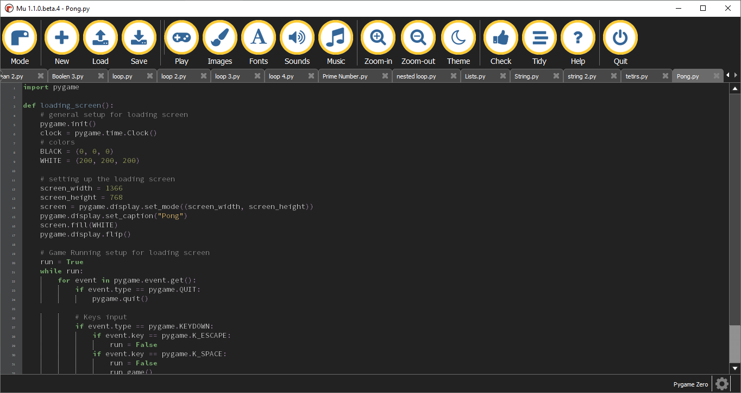
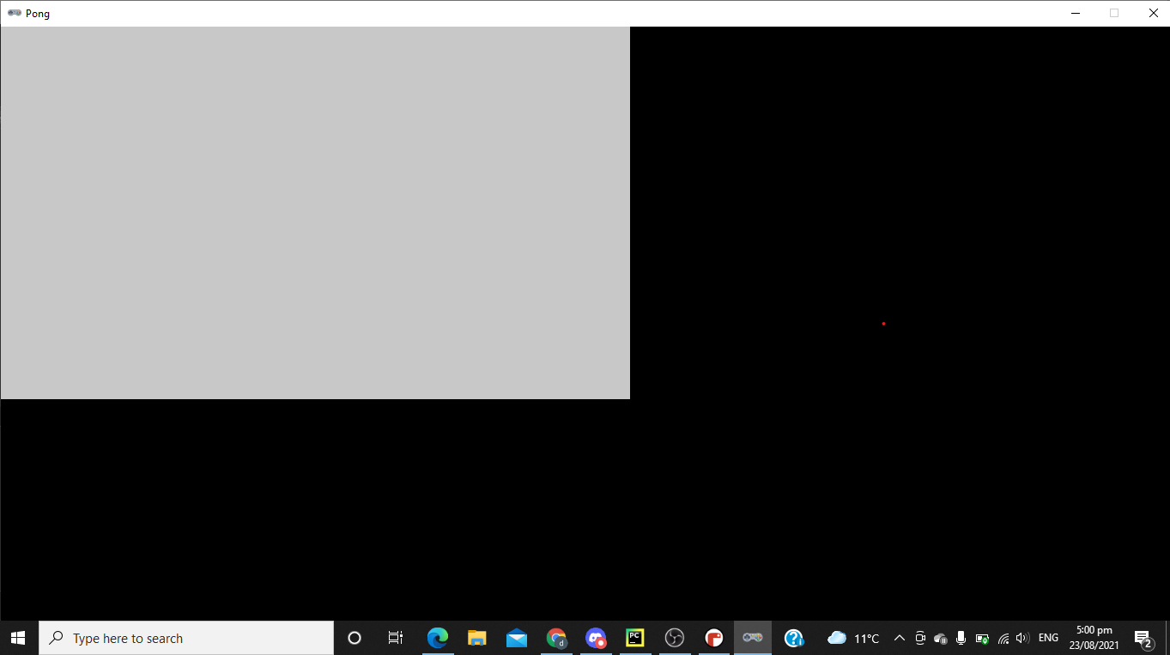

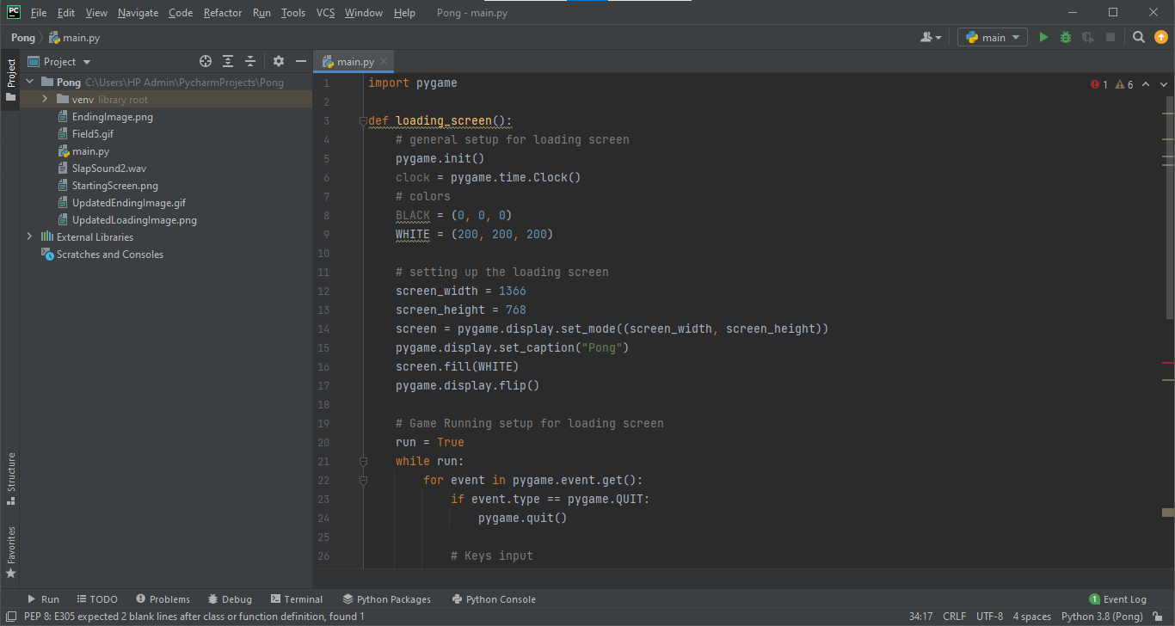
Trialling components (Comparing Alternatives)
Mu Editor Outcome
Pycharm Outcome
(Present this slide to see the images a bit clearer)
Pycharm Outcome

Slide 19
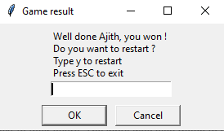
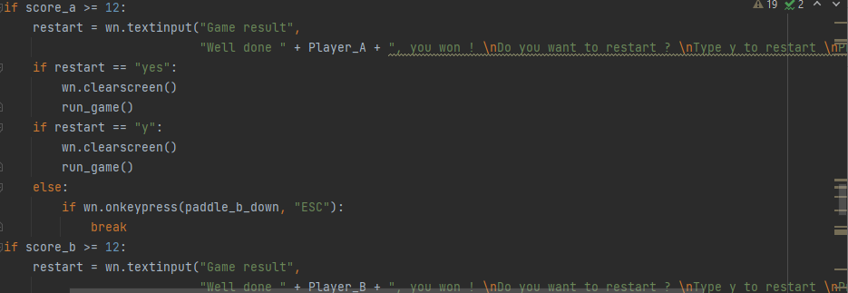
Trialling components (Comparing Alternatives)
For the name input Originally I was just thinking about Player 1 and Player 2 and that would display on the scoreboard. I soon realized that it is a bit boring and it can get confusing on which player is which. So I decided to go with a name input and whatever name input the user gives will be displayed next to their score. The input was also made to only accept letters so no funny names with numbers and symbols. I decided to go with a name input as this helps the users know whos who and the code at the end can congratulate whoever won more specifically. For example if the name was Ajith, it would say “congratulation Ajith, you won”. I also changes the color of color of the two paddles, Originally I was thinking of just plain white to look basic, but after some feedback, it looks way too basics with the plain back background, so I added some colors to the paddle and a field lines so its more pleasing to the eye.
(Present this slide to see the images a bit clearer)

Slide 20
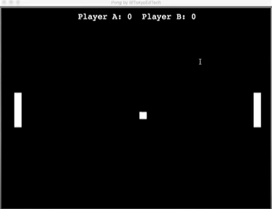
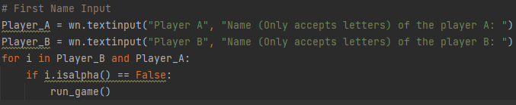
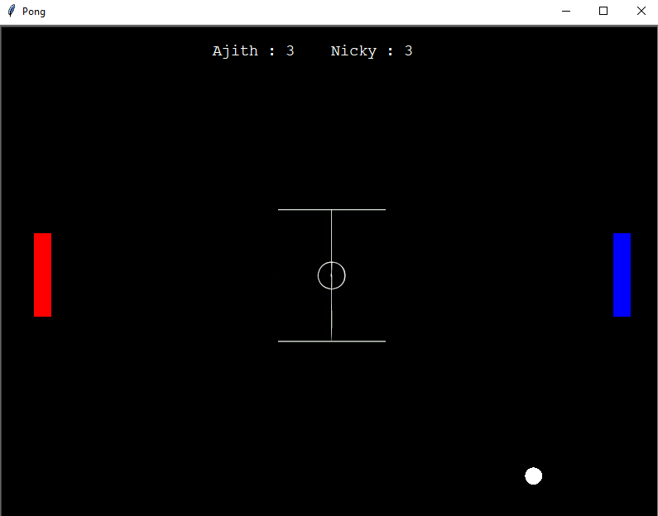
Trialling components (Comparing Alternatives)
(Present this slide to see the images a bit clearer)

Slide 21
Trialling components (Stakeholder Feedback And Addressing Implications)
2.
I first had my parents test out my program and they give me some decent feedback I can do. The first one they immediately thought off was the program needed some more color. The game consisted too much of black and white. So after that feedback I decided to change the paddles into a red and blue for more distinguishing color to make the paddles looks a bit more nice to the human eye. They also said that they don’t like the fact the the ball was a square. A ball logically should be a circle. So I quickly fixed that issue. This was very relevant to the implication aesthetics as this was all about looks and what the human eye sees. So this showed that the aesthetics wasn’t that good being basic.

Slide 22
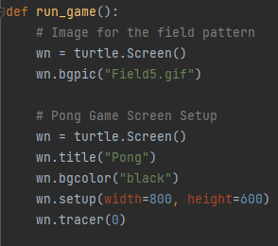
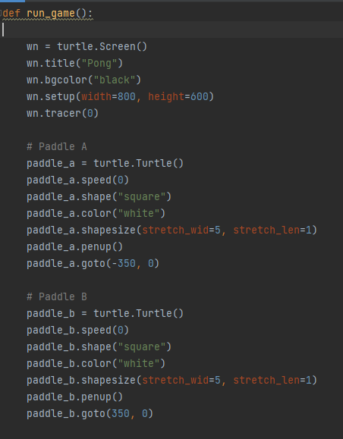
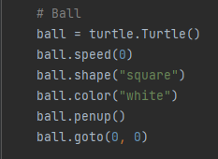
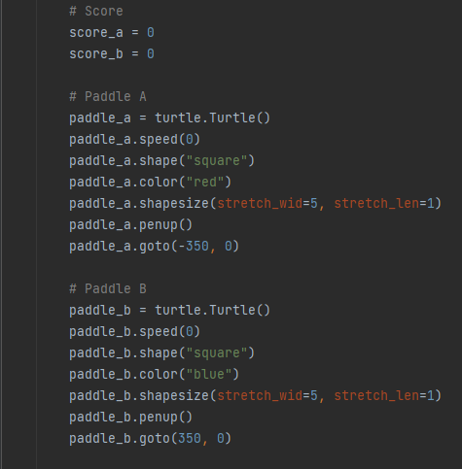
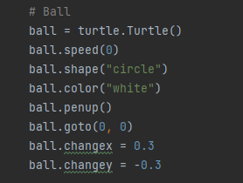
Trialling components (Stakeholder Feedback And Addressing Implications)
(Present this slide to see the images a bit clearer)

Slide 23
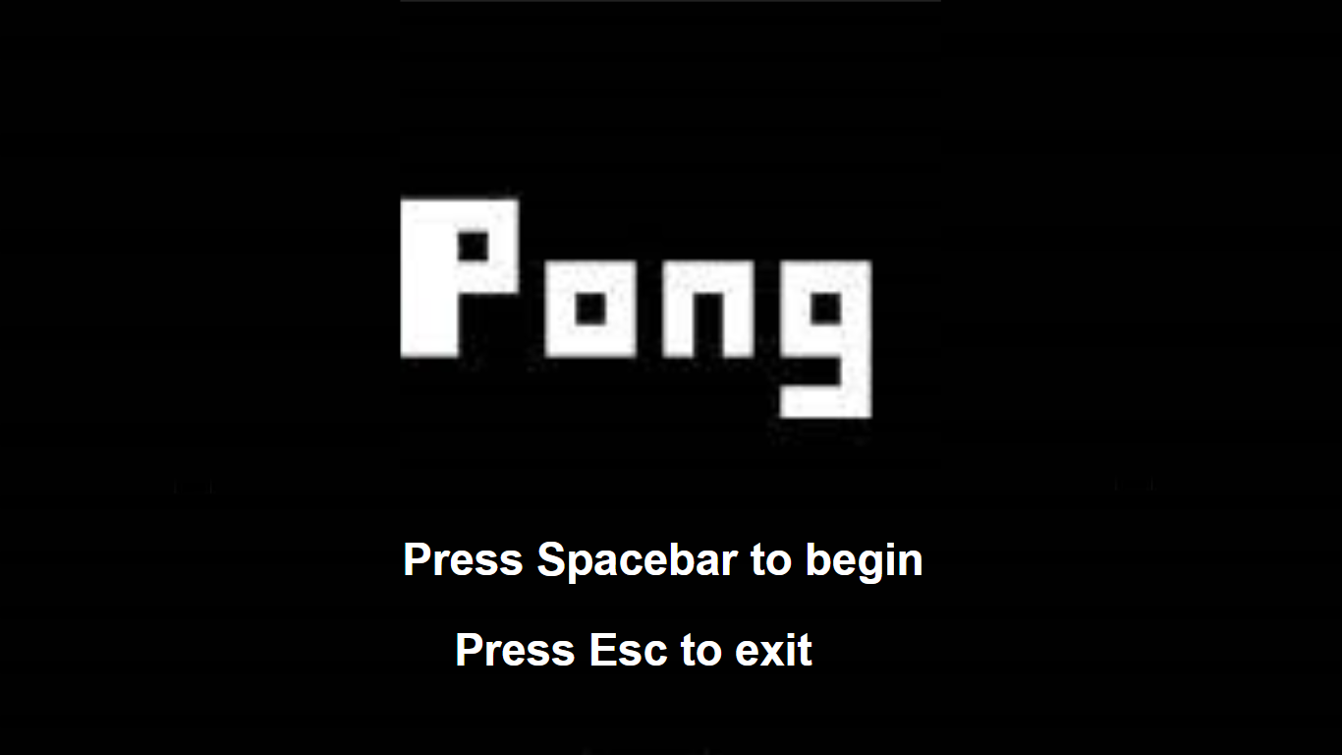
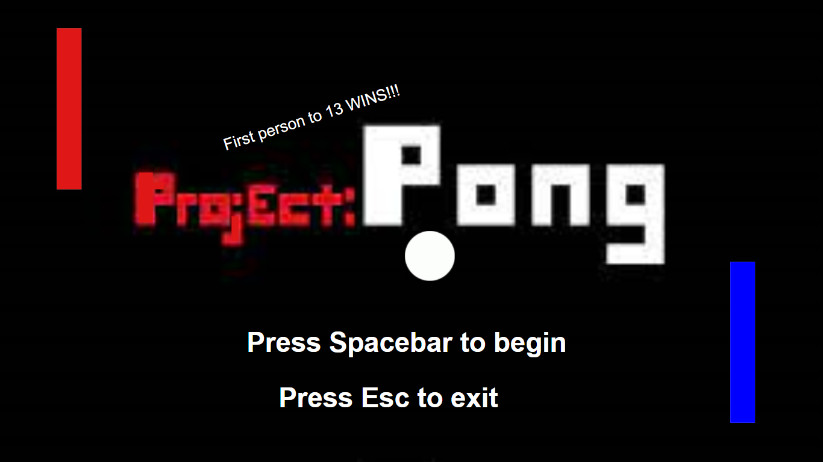
Trialling components (Stakeholder Feedback And Addressing Implications)
2.
When I was making the title screen of my game, my friend Logan walked past and said that looks way too basic and need some color. He then started suggesting a lot of stuff I can add to make it look better. He first said you can add some in game stuff like the paddle and the ball in the title screen. He then said that you need to address what score you need to win, so I just added a small text at the top to address that. Since this was also a school project, Logan suggested that the title should be Project Pong as that sounds really nice and they both start with P. Overall this really helped with the implication aesthetics as now when users enter the program, its looks alot better than before to the human eye and is also a little bit more clear on how to win the game.

Slide 24
Testing outcome
Record evidence that you have tested your outcome.
Explain how the testing made sure your outcome functions as intended to meet its purpose and requirements.
Record evidence that you have used information from testing appropriately to improve the functionality of the outcome.
Debugging
Code validation, PEP8
Testing Tables
Usability testing
Evaluating against requirements
Evaluating against relevant implications.
Final testing of the video (video)

Slide 25
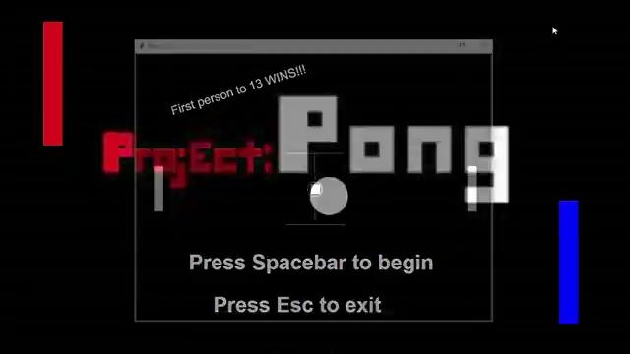
Testing outcome (Bug 1)

Slide 26
Testing outcome (Bug 1)
This first bug I found was where the ball would oddly slide against the paddle and not scoring. I soon realized that the issue was that when the ball was over 340 pixels, it will keep going over that number as their are no restrictions. So i restricted the collision zone between 340 pixels and 350 pixels, and after the collision between the ball and paddle, it will set the ball at 340 pixels, and move it the opposite direction to the other player, in this case it will be a negative value.

Slide 27
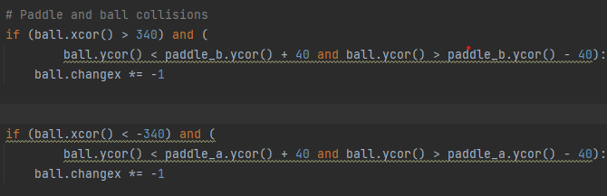
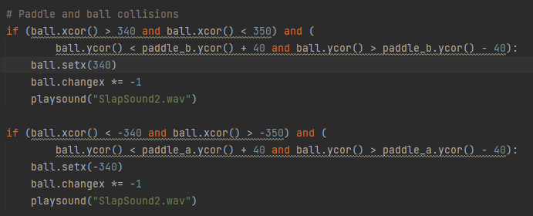
Testing outcome (Bug 1)
Before
After
Present to see clearly

Slide 28
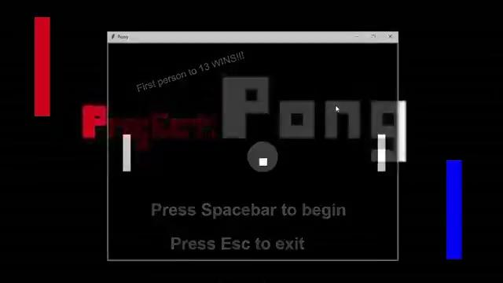
Testing outcome (Bug 2)

Slide 29
Testing outcome (Bug 2)
This bug was kinda odd and very confusing to look for. The issue was in plain sight though. As the screen is like a graph, negative side on the left and positive side on the right the ball would move accordingly to the values give to it. Basically every time the paddle and ball collided, it would set the x value at where it is. Then it would make it positive or negative depending on which side its on. If it was on the left side the x coordinate value of the ball would turn positive to the right. If it was on the right side the x coordinate value would turn negative to go to the left side. But the problem is for the left paddle, the x value should of setted at a negative value, instead I setted it at a positive value, which made it teleport to the right side every time the ball hit the left paddle. This was a complicated but easy fix, I just made the set x value of the left side negative so it sets there and then moves back to the left side.

Slide 30
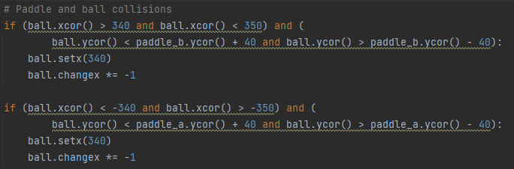
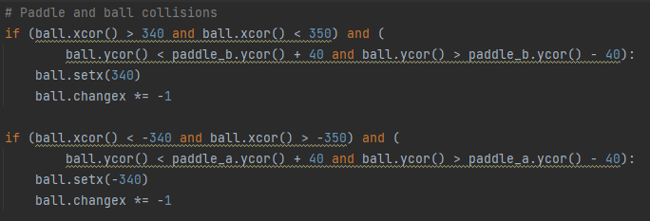
Testing outcome (Bug 2)
Before
After
Present to see clearly

Slide 31
Testing outcome (Bug 3)
This was a really small bug and it did take me a day or two to resolve it as I didn’t really know where the problem was lurking. The image that acts as the title screen wasn’t loading. I soon realized that it was just I wasn’t constantly updating the screen and I was missing the command pygame.display.flip(). It was fixed by adding this command which will update the screen constantly.

Slide 32
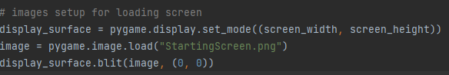
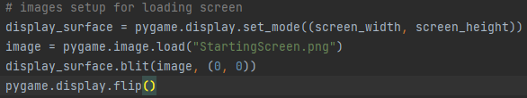
Testing outcome (Bug 3)
Before
After
Present to see clearly

Slide 33
Testing outcome (Bug 4)
Another bug that was found was that the sound for the pong slap was not working. This issue did actually take half a day to resolve. The issue was that the module I was using, Playsound, only accepts WAV files. My sound was in M4A files which made it unable to play the sound. I had to use a online file converter to convert my sound file from M4A to a WAV file.

Slide 34
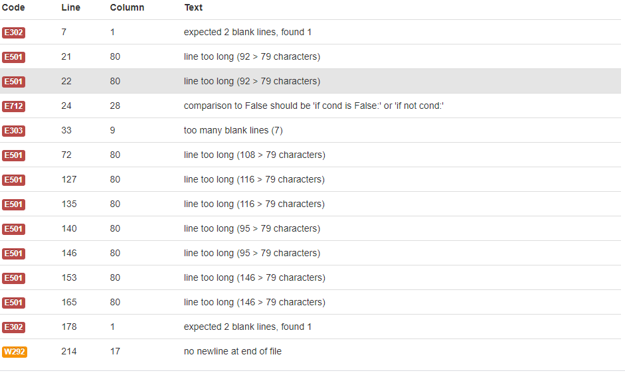
Testing outcome (Code Validation)
(Present this slide to see the images a bit clearer)
2.

Slide 35
Testing outcome (Code Validation)
2.
After my pep8 my code, I fixed many of the errors that popped up. However at the time I thought some of these errors were very irrelevant and that I thought I could of left them. It was stupid of me to think they were irrelevant. I did was not able to see the deeper meaning of these errors. I thought it was unnecessary to fix these errors. One of the errors were the lines were too long. I decided to ignore this one as I thought it was just the sentence input that made it long. It turned out that the score code was also too long. I should’ve fixes this as this made my code look very messy and look fragile. This also might of miss fixing the code at few places and this can lead to a broken functionality. Through this it reminded me why I should of fixed this irrelevant looking error. Another few errors i had was the “too many blank lines” error and the “expected to blanks lines but found 1” error. Again I should of fixed them as they did look irrelevant, but this did make my code look very messy, which could of lead to more bugs I had to fix. Another error that I did not fix was the “comparison to False should be “if cond is false” or “if not cond””. Again I thought this was a unnecessary fix and irrelevant. I soon realized this was considered poor programming practice in Python to use an equivalence comparison to False as a True value in a statement. It can be confusing to future people looking at your code. The last error was the “no new line at end of file”. I didn’t quite know what this meant and I did think this was unnecessary to fix.
However now I know I should’ve of fixed this as this message is displayed because there will be no other no way to tell the difference between a file where there is a newline at the end and one where is not. Diff has to output a newline anyway, or the result would be harder to read for users checking the code.

Slide 36
Testing Outcome (Testing Table For Name Input)
Test Data | Expected Result | Actual Result | Passed Tests | Test Type
1234455 | Data Rejected | Data Rejected | Passed | Invalid
-123+1546- | Data Rejected | Data Rejected | Passed | Invalid
Player On the Left | Data Accepted | Data Accepted | Passed | Valid
!@%#^_$&*#? | Data Rejected | Data Rejected | Passed | Invalid
PLAYER NICKY | Data Accepted | Data Accepted | Passed | Valid
00312!@#$!Nick | Data Rejected | Data Rejected | Passed | Invalid
3.

Slide 37
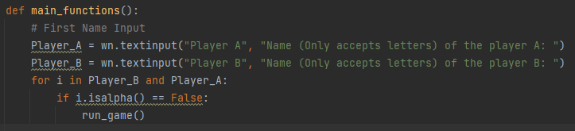
Testing outcome (Usability Testing)
4.
Another person I had test my program was my teacher. She said that the name input needed to be more strong. It shouldn’t be able to accept numbers or anything else that isn’t letters. So after teaching me a quick method on inputs only accepting letters, the program was a bit better with these small details. The names now wasn’t able to be numbers or other weirds symbols, only letters.

Slide 38
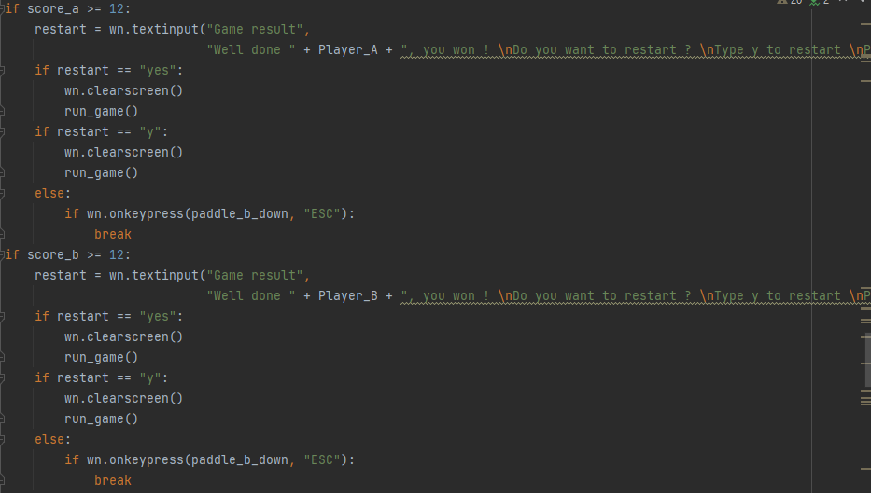
Testing outcome (Usability Testing)
(Present this slide to see the images a bit clearer)
4.
So when my friend Ethan tested out my program he's found everything all useable. The one thing he did say though was at the end. He said it can be very inconvenient and annoying to type out yes to restart the code. He said that the code should accept Y and yes so its not too hard for the user. He also said that typing no is hard so I just did enter nothing to break the program and exit out.

Slide 39
Testing outcome (Evaluating against requirements)
6.
The requirements I set out was at the very least, a working pong game that had a score and was able to be played by many users with their friends. At the end I think it turned out almost the same as I envisioned the project to be. There are two working paddles that can move up and down. The ball is constantly moving and the collisions between the border and the paddles are working. I think ahestically it looked a bit better then the requirements I set out. I first just wanted it to look as basic as possible. I soon realized that this was not too good ahestically and needed some color and stuff, so some color was added to the game and title screen. The requirements for this game was mostly for entertainments between teenagers mostly. Teengaers these days don’t like things too basic these days, so I made the paddles red and blue to make it more aesthetically pleasing to the teenagers. Teenagers also love to mess around with almost anything these days, so I made a name input just for them to mess around with and come up with funny names for their entertainments. Teenagers these days also love to play the game with friends, so I made the game two player instead of it one player versing a bot. This can also help the two friend relieve some stress and have some fun and entertainment.

Slide 40
Testing outcome (Evaluating against relevant implications.)
7.
I applied many implications to the projects to makes the project as good as it can get. One was aesthetics. This was a very important implication as most things are all about aesthetics. It grabs peoples attention and it looks more aesthetically pleasing. This will make my project experience a bit more enjoyable. The aesthetics was pretty basic as it was black and white, but later changed to make it look more eye catching, so red and blue was added to the paddles. The reason the aesthetics was made basic with black and white because most color blind people will be able to see black and white, so color blind people and normal people will be able to see the same thing. Even though the paddles were changed to red and blue, it still won’t have a massive impact to color blind people will still be able to see the paddles with any type color blindness.
The second one was usability. Again this was very important as the usability must be efficient as possible. Every usability must be efficient and make sense. The buttons for paddles was made W key and the s key for one paddle and the up key and down key for the second paddle as these buttons were normal for gaming as normal gaming games usually consist of WASD keys and arrow keys. The exit key was made escape as it is just makes sense to. Normal gaming keys make escape as the exit key and escape does mean leaving, so it just makes sense to. These keys were made chosen as these keys are considered normal for gaming so it won’t get too confusing the the user that's playing my program.

Slide 41

Testing outcome (Final Testing)
8.

Slide 42
Version Control
Your version control evidence should go here. This could be in the form of annotated screenshots which show you you managed this process or you could make a brief screencast explaining how you implemented version control.
(basically how I saved copies of code) More pictures less writing here

Slide 43
Version Control
Why did I use Pycharm controlling version control (code history)?
I chose Pycharm code history to save different versions of my code was because it was convenient and easy. It was convenient because Pycharm was also where I was writing my code. So I didn’t have to go onto a different program just to save versions of my code. I didn’t use Github because I didn’t really have enough time to learn how to use it and it did look a bit complicated just to save versions of my code. I could of also paster my versions of code on sperte google docs with the date and stuff, but that would get messy as there will be too many googles docs and it would get lost with my other work such as english.

Slide 44
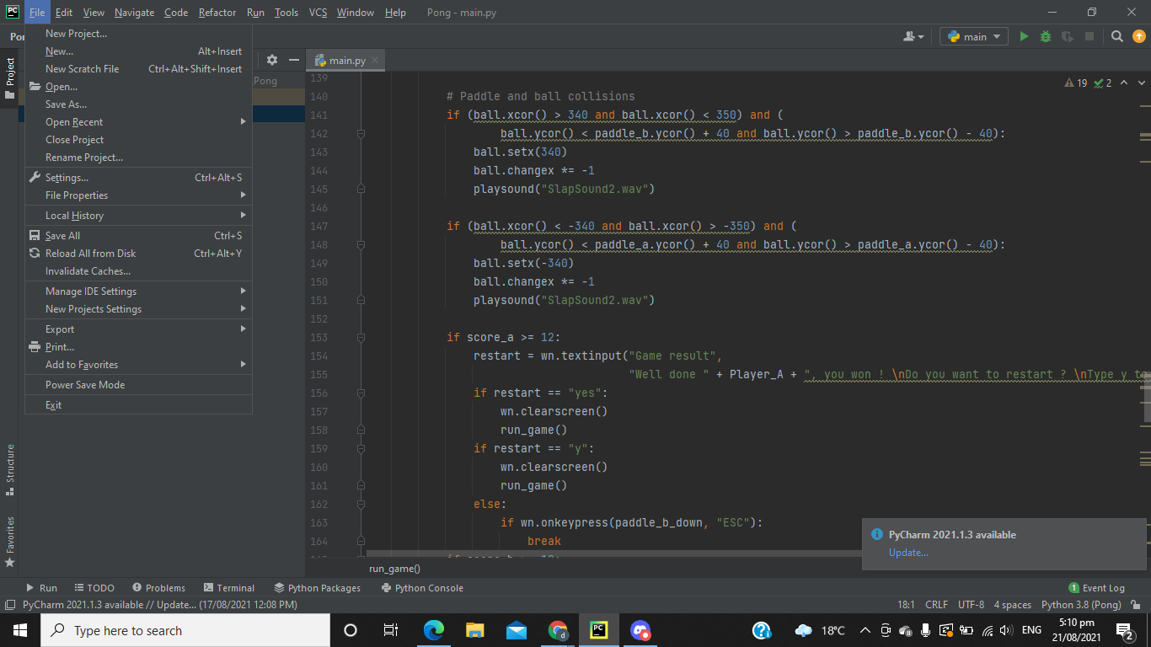
Version Control
(Present this slide to see the images a bit clearer)
Why did I use Pycharm controlling version control (code history)?
I chose Pycharm code history to save different versions of my code was because it was convenient and easy. It was convenient because Pycharm was also where I was writing my code. So I didn’t have to go onto a different program just to save versions of my code. I didn’t use Github because I didn’t really have enough time to learn how to use it and it did look a bit complicated just to save versions of my code. I could of also paster my versions of code on sperte google docs with the date and stuff, but that would get messy as there will be too many googles docs and it would get lost with my other work such as english.

Slide 45
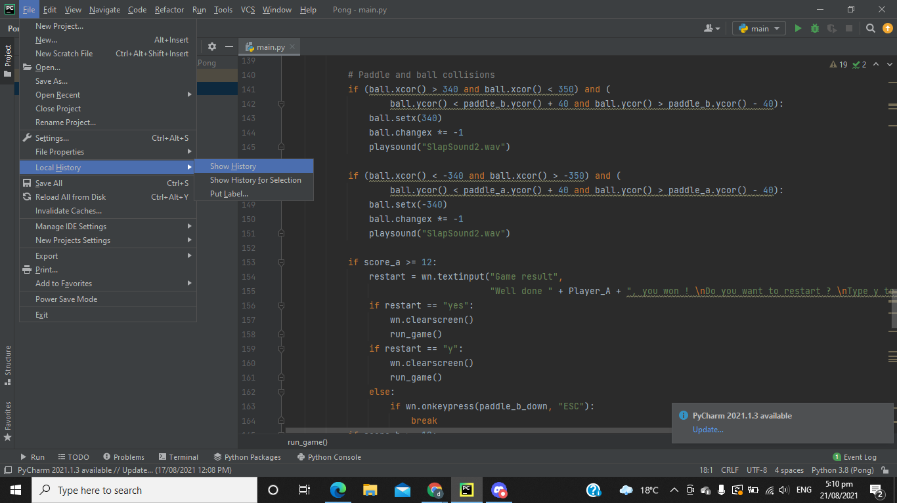
Version Control
(Present this slide to see the images a bit clearer)
Why did I use Pycharm controlling version control (code history)?
I chose Pycharm code history to save different versions of my code was because it was convenient and easy. It was convenient because Pycharm was also where I was writing my code. So I didn’t have to go onto a different program just to save versions of my code. I didn’t use Github because I didn’t really have enough time to learn how to use it and it did look a bit complicated just to save versions of my code. I could of also paster my versions of code on sperte google docs with the date and stuff, but that would get messy as there will be too many googles docs and it would get lost with my other work such as english.

Slide 46
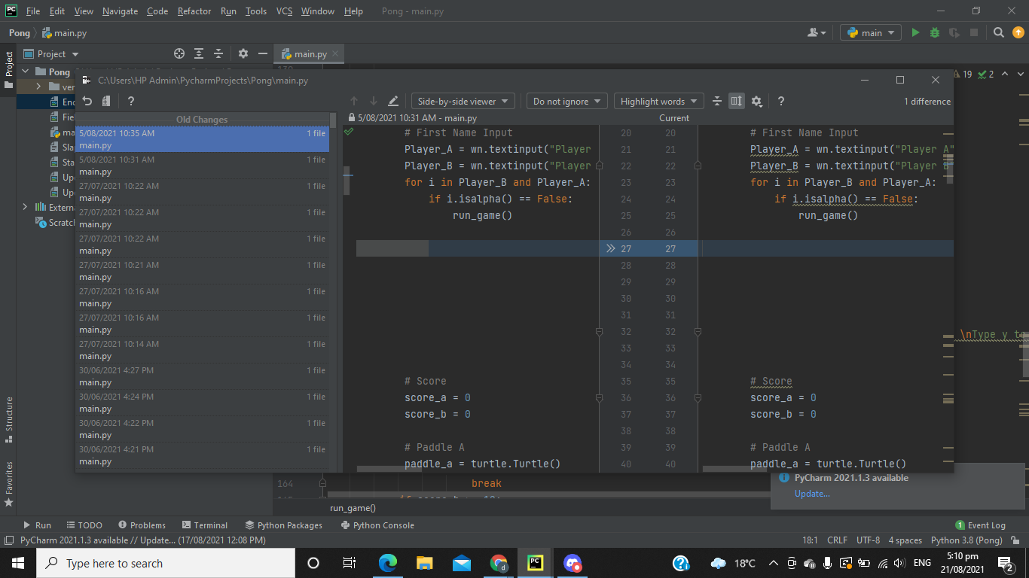
Version Control
(Present this slide to see the images a bit clearer)
Why did I use Pycharm controlling version control (code history)?
I chose Pycharm code history to save different versions of my code was because it was convenient and easy. It was convenient because Pycharm was also where I was writing my code. So I didn’t have to go onto a different program just to save versions of my code. I didn’t use Github because I didn’t really have enough time to learn how to use it and it did look a bit complicated just to save versions of my code. I could of also paster my versions of code on sperte google docs with the date and stuff, but that would get messy as there will be too many googles docs and it would get lost with my other work such as english.

Slide 47
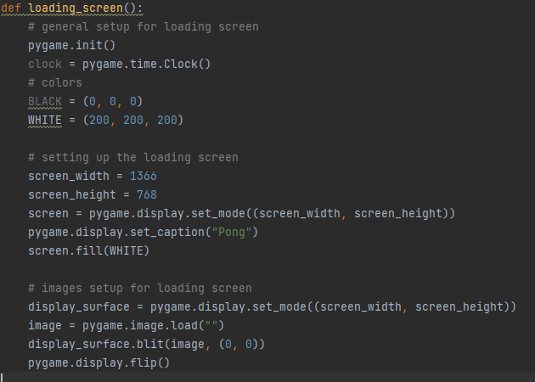
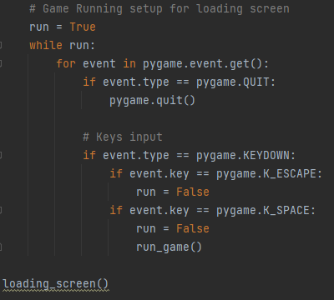

Version Control
(Present this slide to see the images a bit clearer)
Version 1: Outcome:
Without Title Image
With Title Image

Slide 48
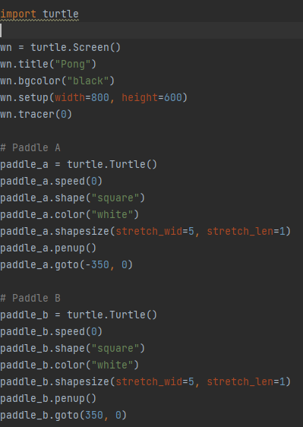
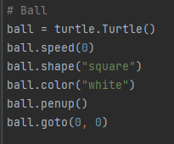
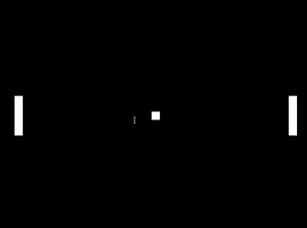
Version Control
(Present this slide to see the images a bit clearer)
Version 2: Outcome:

Slide 49
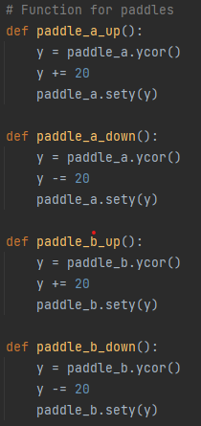
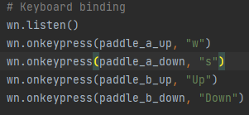
Version Control
(Present this slide to see the images a bit clearer)
Version 3: Outcome:
(Paddles can now move)

Slide 50
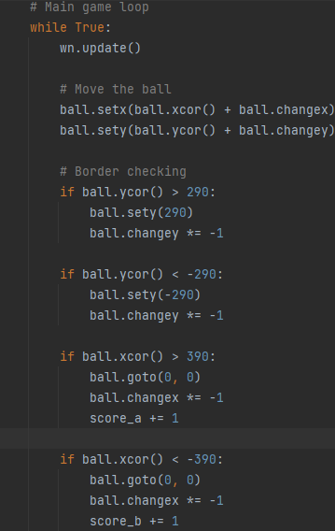
Version Control
(Present this slide to see the images a bit clearer)
Version 4: Outcome:
Ball can now move and collide with border and now if someone scores the ball goes back to the middle

Slide 51
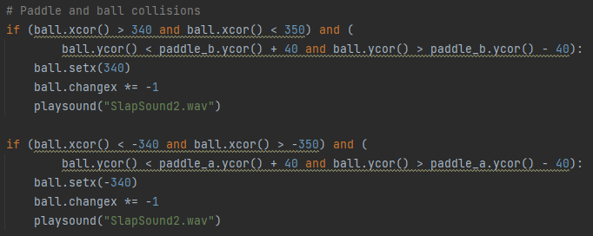
Version Control
(Present this slide to see the images a bit clearer)
Version 5: Outcome:
Paddle and ball collision

Slide 52
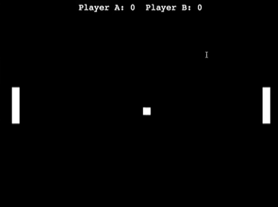

Version Control
(Present this slide to see the images a bit clearer)
Version 5: Outcome:
Score system and GUI inputs

Slide 53


Version Control
(Present this slide to see the images a bit clearer)
Version 5: Outcome:
Minor changes such as color, shape, field and name input for the scoreboard.

Slide 54
Project management: Applied
Record evidence that you have used your project management tools to manage the development of your outcome. Treelo board
Record evidence that you have used your project management techniques to manage the development of your outcome.
Record evidence that you have used version control tools to manage the development of your outcome.

Slide 55

Project management: Applied
(Present this slide to see the images a bit clearer)
Record evidence that you have used your project management tools to manage the development of your outcome. Treelo board
Record evidence that you have used your project management techniques to manage the development of your outcome.
Record evidence that you have used version control tools to manage the development of your outcome.

Slide 56

Project management: Applied
(Present this slide to see the images a bit clearer)
Record evidence that you have used your project management tools to manage the development of your outcome. Treelo board
Record evidence that you have used your project management techniques to manage the development of your outcome.
Record evidence that you have used version control tools to manage the development of your outcome.

Slide 57

Project management: Applied
(Present this slide to see the images a bit clearer)
Record evidence that you have used your project management tools to manage the development of your outcome. Treelo board
Record evidence that you have used your project management techniques to manage the development of your outcome.
Record evidence that you have used version control tools to manage the development of your outcome.

Slide 58

Project management: Applied
(Present this slide to see the images a bit clearer)
Record evidence that you have used your project management tools to manage the development of your outcome. Treelo board
Record evidence that you have used your project management techniques to manage the development of your outcome.
Record evidence that you have used version control tools to manage the development of your outcome.

Slide 59

Project management: Applied
(Present this slide to see the images a bit clearer)
Record evidence that you have used your project management tools to manage the development of your outcome. Treelo board
Record evidence that you have used your project management techniques to manage the development of your outcome.
Record evidence that you have used version control tools to manage the development of your outcome.

Slide 60
Relevant Implications
Explain the relevant implications here. Please watch this video to learn how to do this.
Explain the Implications that are relevant to your outcome.
Record evidence that you have addressed the Implications that are relevant to your outcome.
(need some screenshot for evidence)

Slide 61
Legal
This first implication is the legality of my game. I had to make sure I choose softwares that was legal and free to ensure that I won’t be In court after i make the game. I used pycharm which was completely legal to write my code and test my code because it is easy to use, free application and is compatible with other coding language so your not restricted to one coding language. I could download/ install other support modules to help with my product. I also made sure the images I used for my product was completely free, to avoid copyright and stuff like that. I plan to distribute my game digitally as it's a small game. I will use applications to distribute my game such as Steam. Due to laws and copyright issues, the games assets such as the title and logo were made by me to avoid any copyright infringement. I also make sure the program does not ask for any private information as that would be troublesome as there could be online hackers that could hack my program. Security does not exist in my program. I used photoshop to make the title screen, which is completely legal and I do have the licence to use it because the school provided us with the adobe suite for us. The title screen was made through photoshop, using a red square and a white square and just stretching the shapes into the desired look, which is project pong.

Slide 62


Legal
(Present this slide to see the images a bit clearer)
This first implication is the legality of my game. I had to make sure I choose softwares that was legal and free to ensure that I won’t be In court after i make the game. I used pycharm which was completely legal to write my code and test my code because it is easy to use, free application and is compatible with other coding language so your not restricted to one coding language. I could download/ install other support modules to help with my product. I also made sure the images I used for my product was completely free, to avoid copyright and stuff like that. I plan to distribute my game digitally as it's a small game. I will use applications to distribute my game such as Steam. Due to laws and copyright issues, the games assets such as the title and logo were made by me to avoid any copyright infringement. I also make sure the program does not ask for any private information as that would be troublesome as there could be online hackers that could hack my program. Security does not exist in my program.

Slide 63



2. Usability
(Present this slide to see the images a bit clearer)
The usability was made as simple and clear as possible. The username is inputted and is made sure that only letters are accepted. The start screen is just Space bar to play and Esc to exit. It is as basic as possible so it is user friendly and not too overwhelming. I should’ve of added instructions on the buttons of the players, which is the simple Up key and down key and the W key and S key.

Slide 64
3. aesthetics
The colors were pretty basic as there wasn’t much to add on the project. A simple field with white lines was added to make it look a bit more pleasing to the eye. It was originally part of the plan but the black background didn’t look too good. The pong also had a blue and a red color as this helped the pad look it bit more distinct more pleasing to the eye. The color were chosen as they were pretty basic and they don’t blend in with the black background.

Slide 65
Evaluate
Discuss how the information from planning, testing and trialling of components assisted in the development of a high-quality outcome.
(what went well or what went bad? Improvements for next time…)

Slide 66
Evaluate
At the end I think all these processes made me work better because it helped me be more organised. With Trello I was able to keep on track on the work easily. I was constantly reminded to get back to work and when it was due and had to be done. There were many commands from Trello board that helped. For example the first one was the due date command. This command was great as a reminder to remember to finish stuff on time. This command can add a red label and a warning sticker to the specific week card when it is overdue. This was very useful as it was a great reminder on what I haven’t done. If I forgot to do that week's specific tasks, I would know as its very distinguish from other cards with red labels and warning stickers. This command applies for every week tasks, so any week task that was not in the done list will go into the overdue list. Another tools that was useful was the calendar command. This was a great tool as I can make commands such as every wednesday afternoon it automatically creates a card called “Weekly update”, which really helps to keep on track and where the development of this outcome is. If something odd like a bug pops up or something is taking up more time than anticipated, then I can write in the week update card what happened and how I plan to resolve it, such as the collision coding, I anticipated it to take up a week, but it ended up taking more than a week, so I planned out what I was planning to do. Another cool thing I can do with the calender command is that I can send reports every monday of anythings that's overdue to me email. Again this was very good as a reminder and every monday before I get onto that week work, the trello board emails me about anything overdue. One more final useful tool the board button and card button commands. With the Card button I was able to use it to move cards easily, the cards were the tasks I had to do each week. I also used the card button command to create done button, so whenever I completed that week of assignments, I click the done button and that would move that card to the done list. This was very helpful to keep track what was done as if it wasn’t there, I would get very confused on what task I need to do, worst I wouldn’t even remember what week I’m on.There was another very simple tool on trello where it tracks whatever activity has been done, basically a history list. This was easy to keep track on my work and revert stuff back to its original state.

Slide 67
Evaluate
I tried many functions of my program and at the end the code was working with a basic pong game and basic pong game title. After reflecting on the stakeholder feedback and comparing alternatives, I was able to polish up and make my code a bit better. For example I made a name input for the score, I changed the game title screen to look more aesthetically pleasing and I changed some basic stuff from my stakeholder feedback that my program looks to basic. I added some simple colors to the paddles which does make it look alot better.
The version control on Pycharm really helps as I was able to find bugs and randoms errors easily. If I saved a working version of my code and I added something new and a new bug pops up, I would know it's something to do with the new code I added and go back to my original version and retry and fix it. This really did help me alot with my coding. I compared a lot of alternatives such as the software I used for my python code. For example I compared Mu Editor and Pycharm. I chose Pycharm as it could do a lot more than Mu Editor such as the history for version control and Mu Editor was a lot more buggier and lacked a lot of functions from Pycharm.

Slide 68
Evaluate
I tested my game thoroughly to ensure no random bugs pops up and that the game can run smoothly as possible. For example there were many bugs such as the ball where collision with the paddles and the ball weirdly teleporting. Constantly testing out whatever new code I added was good as this could ensure that everything was working as smoothly and efficient as possible. Also having other people test out my code was good as they were able to spot small details that I cannot spot. Doing usability testing also helped my code become more polished up and help fix small problems that can be fixed and done.
What I could of done better was not ignore small stuff that I thought were irrelevant, such as the pep8 validation, where I thought the error were irrelevant but that's what probably lowered my grade. I will improve by doing everything that is said to be done. If I have to fix small errors I will fix it. I reckon I should’ve also Pep8 a lot more just like how I tested my code a lot throughout to make the code as perfect as possible.
But overall I think I did alright and got most of the things done on time. A code that at the very least runs alright and works.

